Slide 1
Evaluate the Effectiveness of Dashboard:
Our health and wealth over 221 years compressed into a minute
Group 10

Slide 2

To begin with
Who we are?
A non-profit organization
Who we serve?
The public
What’s our goal?
Arise the public’s attention to the relationship between wealth and health

Slide 3
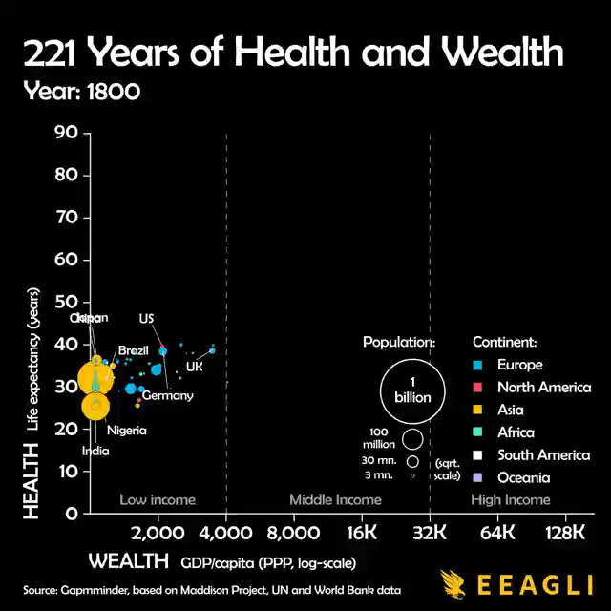
Introduction of the dashboard
Input and Output
Year, wealth, health, population, continent data, historical event
A changing scatter plot
Metrics of Success
778 comments
20.5k likes
https://www.reddit.com/r/dataisbeautiful/comments/lmlrks/oc_our_health_and_wealth_over_221_years/
Notes:
[OC] Our health and wealth over 221 years compressed into a minute : dataisbeautiful (reddit.com)
The comment/share/like of the video

Slide 4
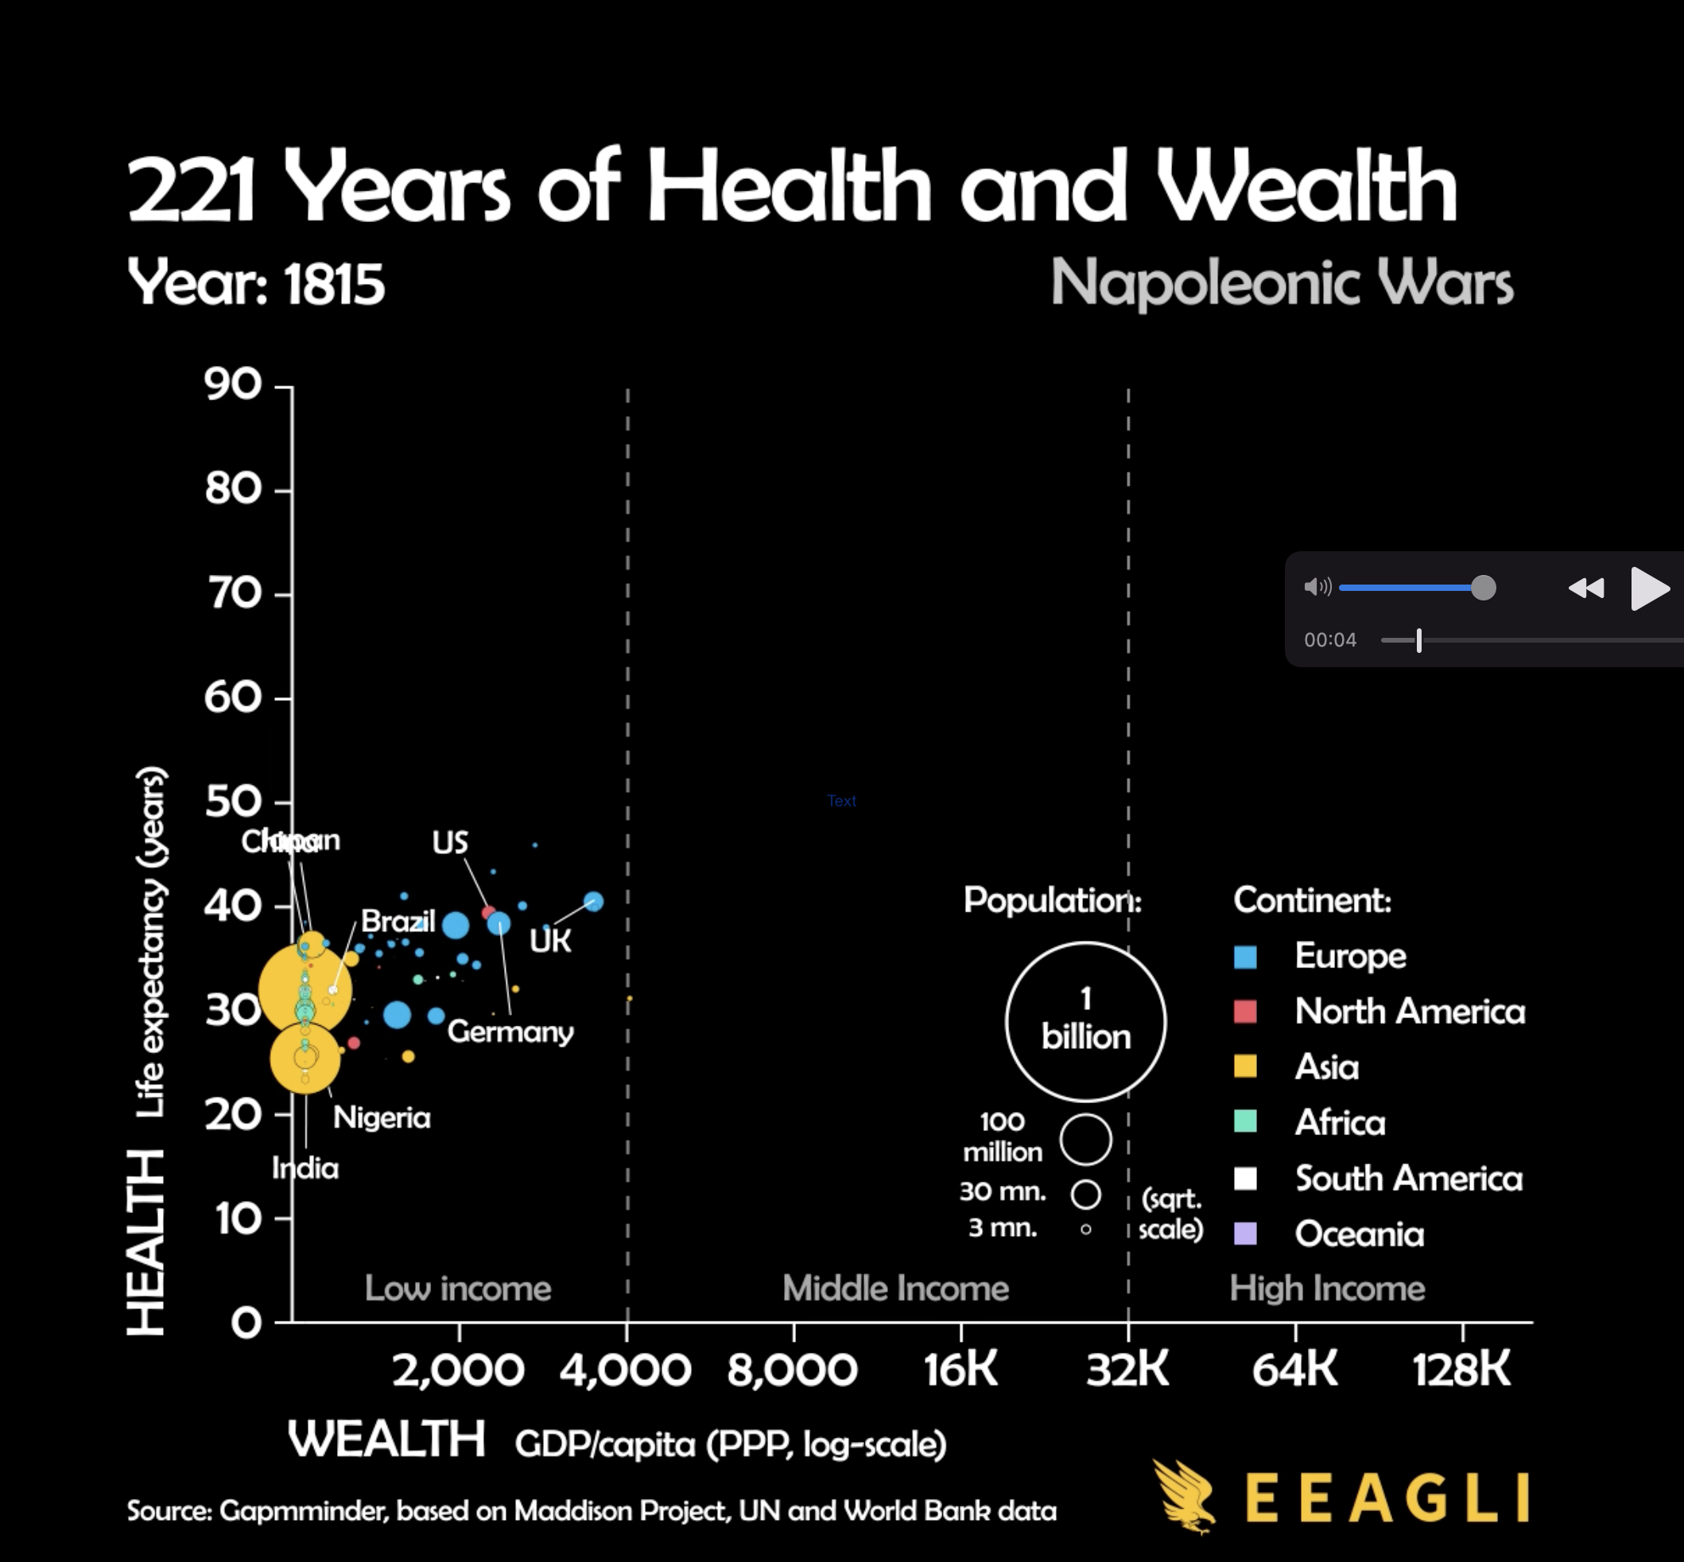
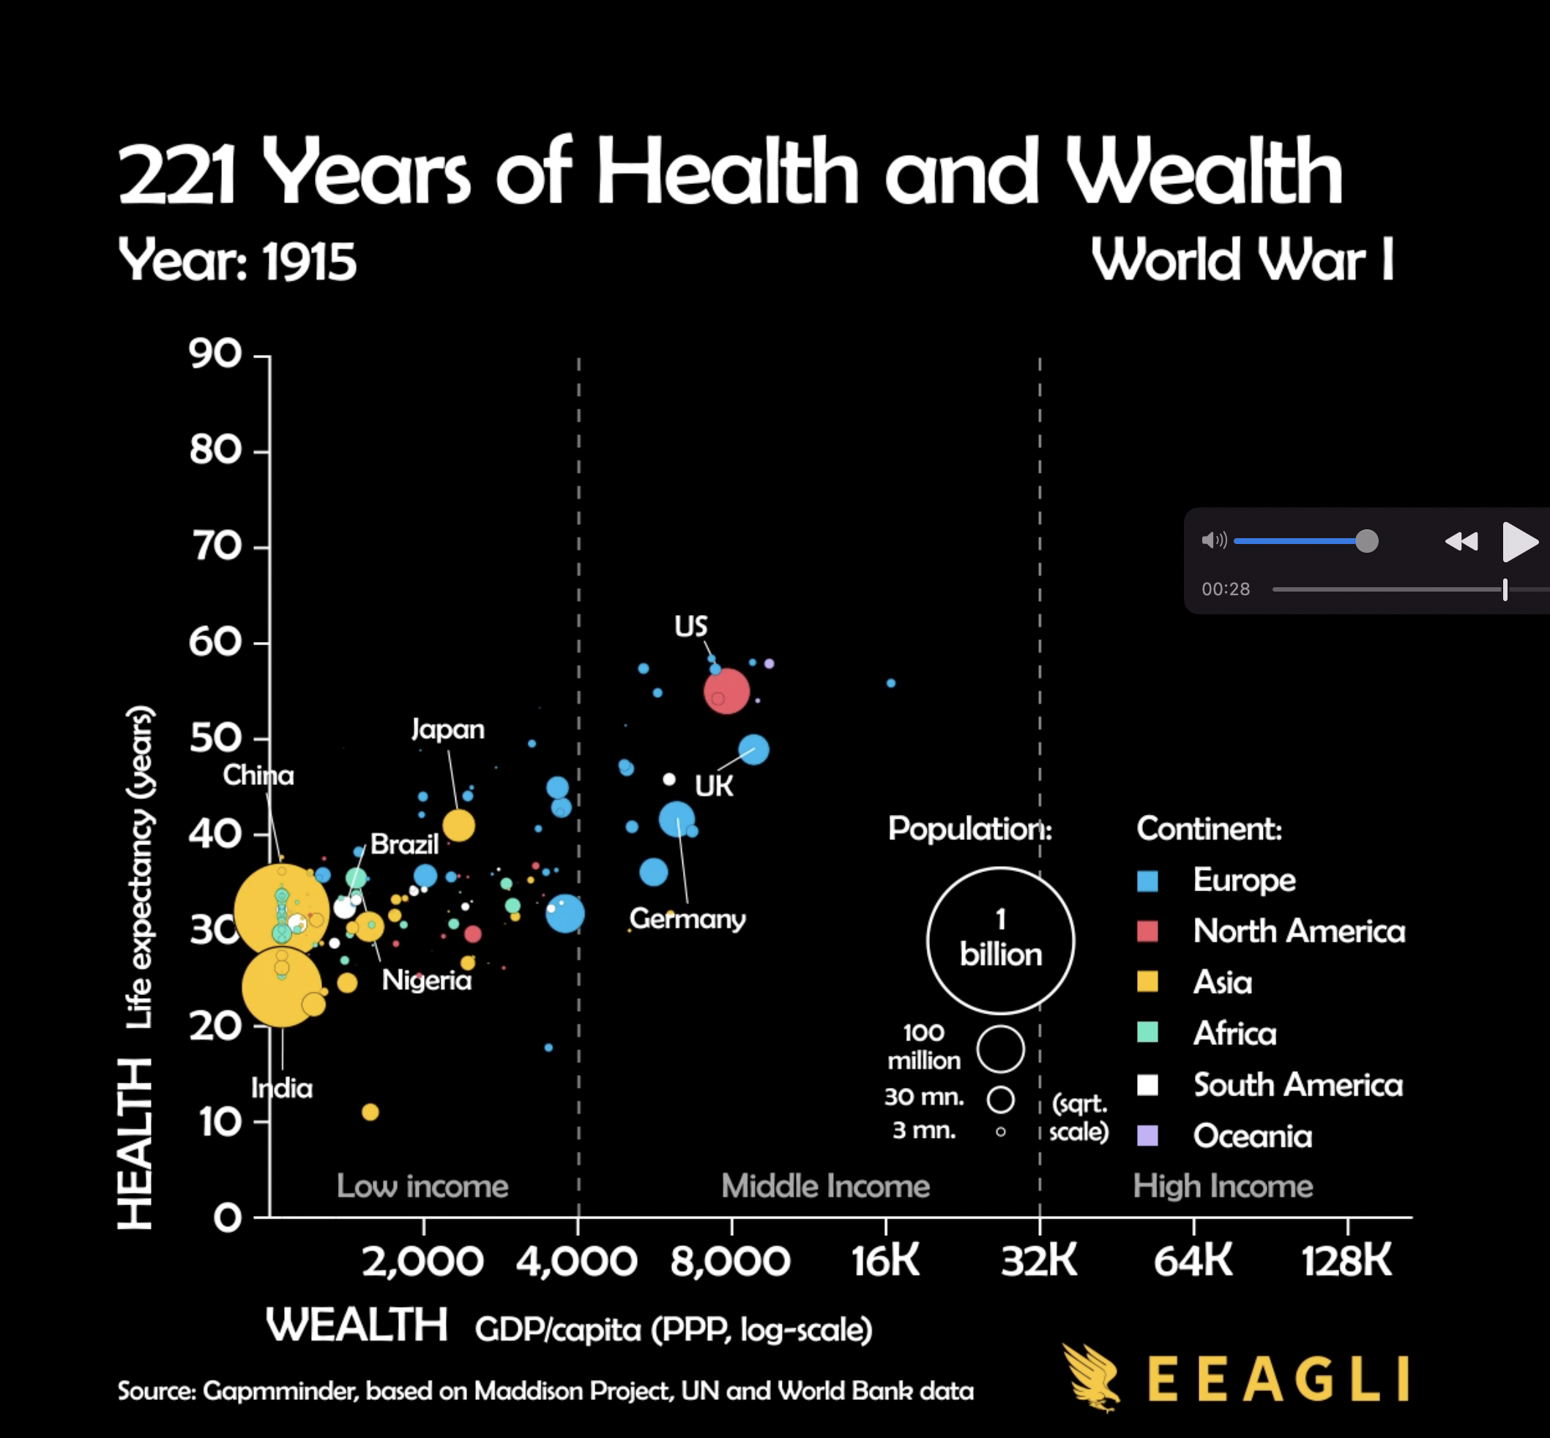
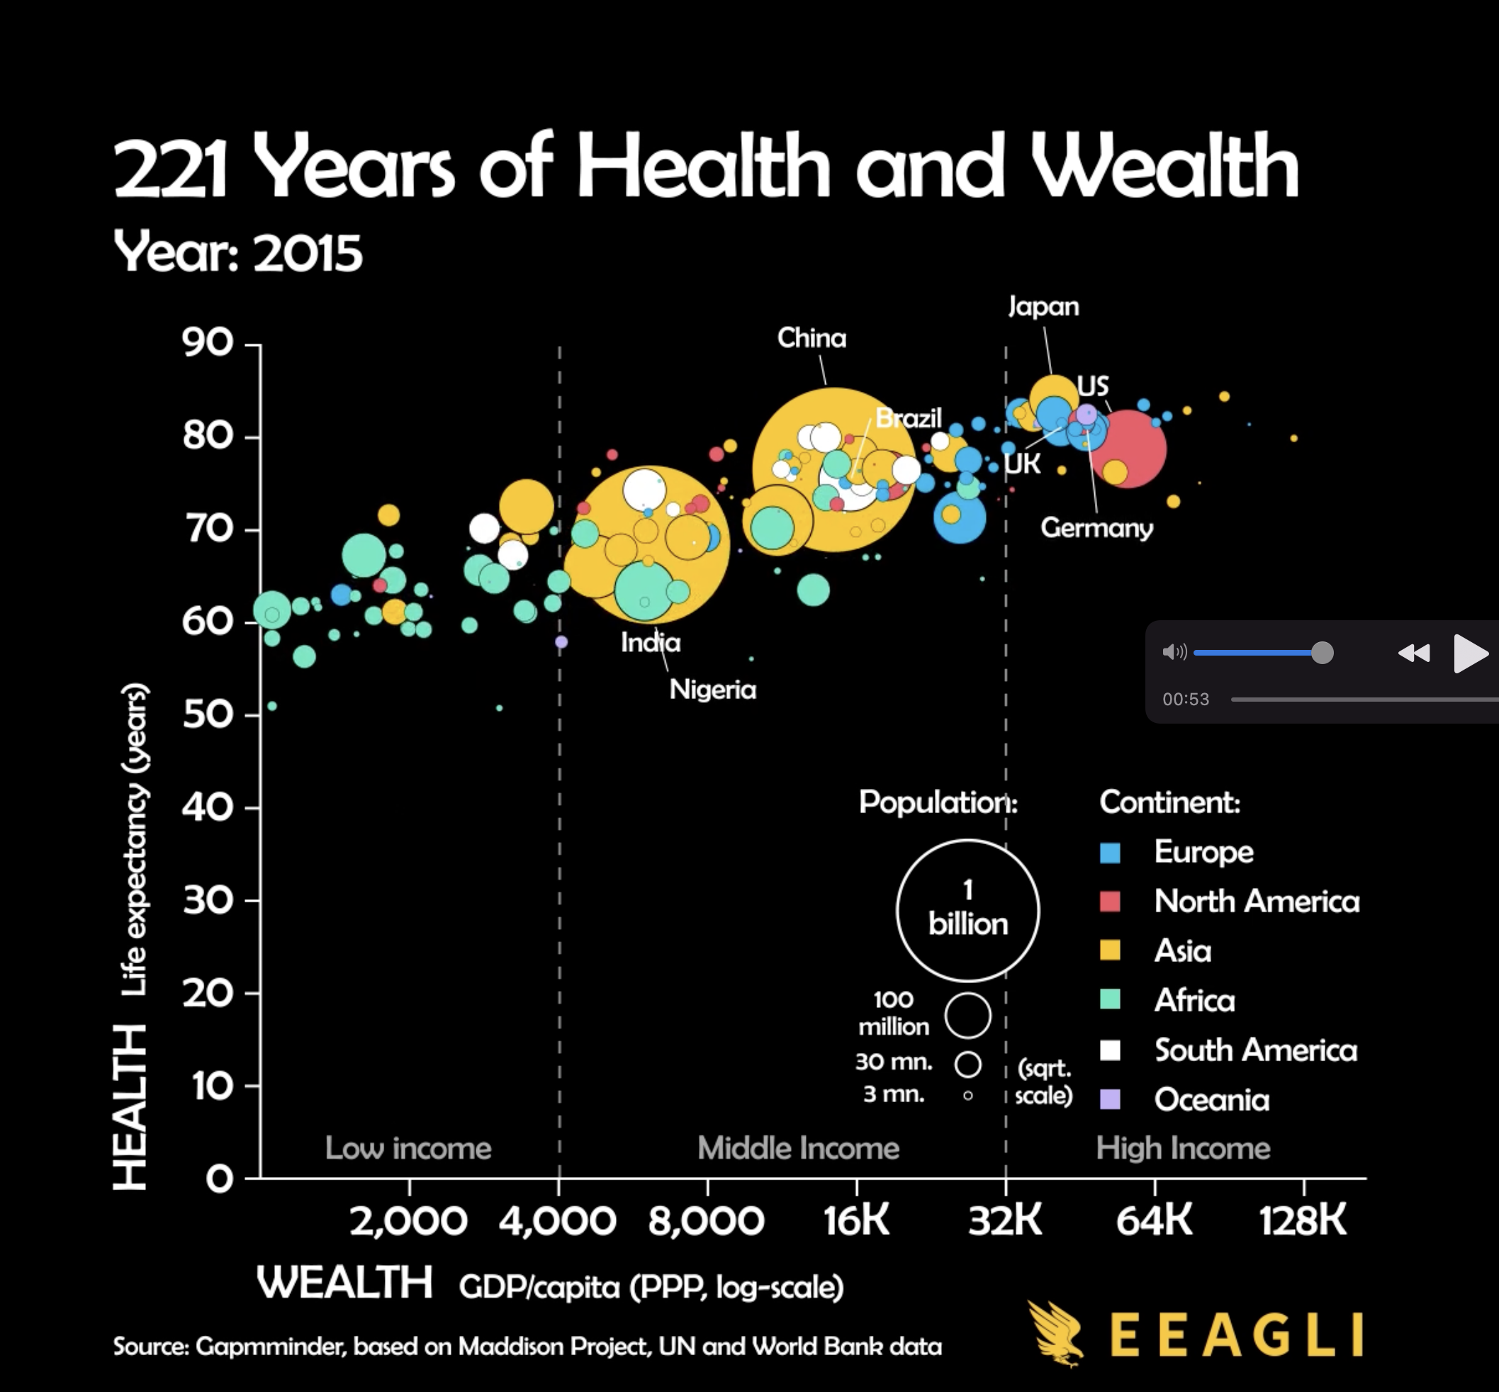
Main story
Correlation between Health and Wealth by Time Trend
c
Storytelling with data trends structure
The number of dimensions match the number of variable
Pick the right tool for the job
Form Follows Function !
Notes:
Flow is storytelling
Pick the right tool for the job: logscale可以让最近高速发展的gdp纳入表内,sqrtscale可以让点的大小差距不会太大

Slide 5
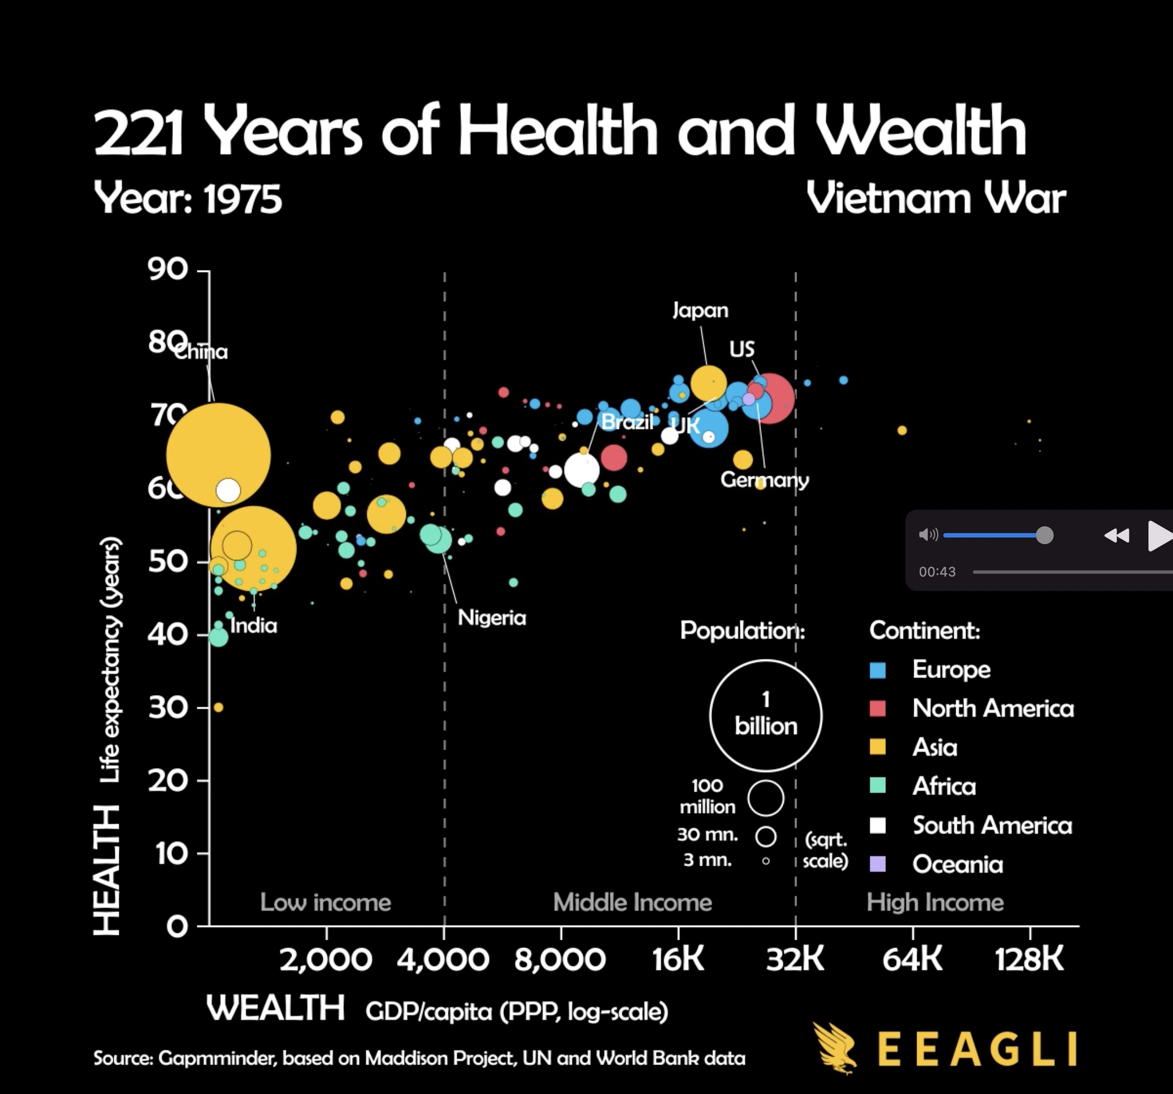
Minor Stories
Population change by time
Continent development by time
Important historical event
High Data-ink Ratio !
Notes:
然后口头总结前面讲的这个图做的好的地方

Slide 6
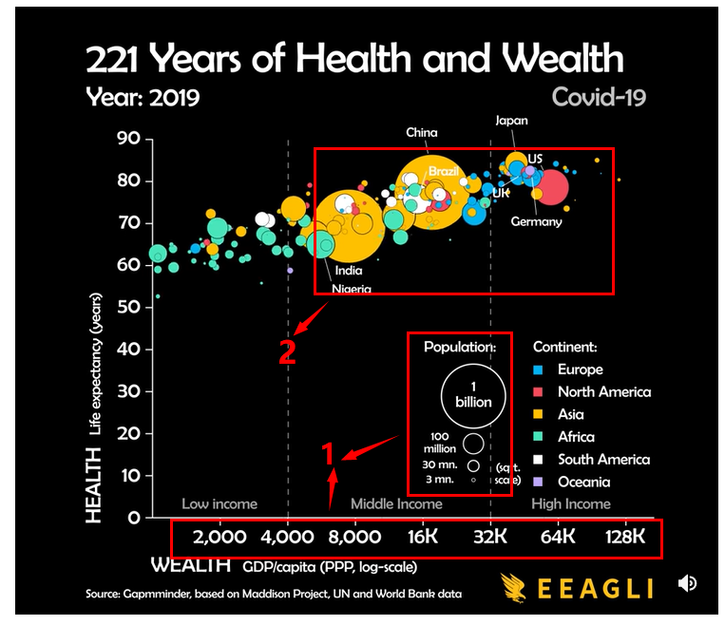
Disadvantages
1 Misleading Number Scale
- Wealth & Population
2 Too many information
3 Lack of interactivity
Notes:
2min
c

Slide 7
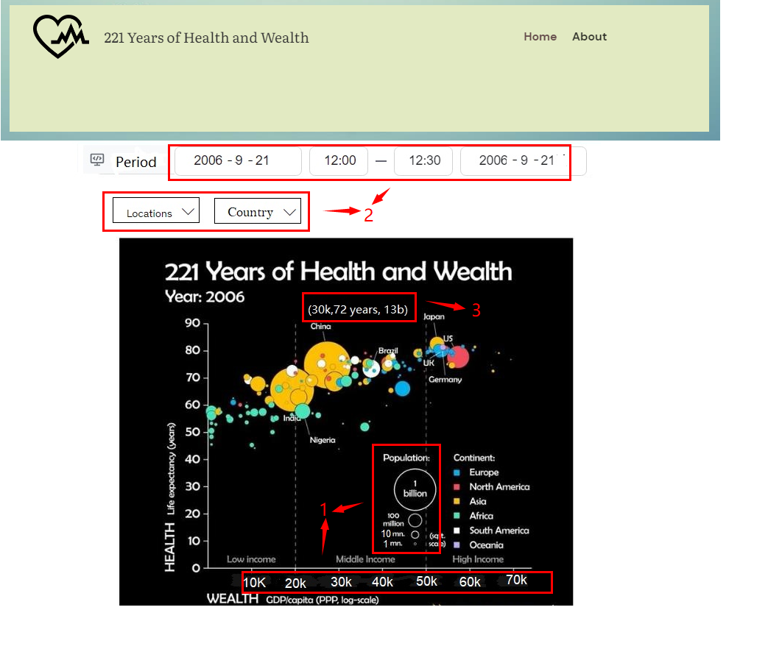
Stay tuned for the new web version-Health Center
Before（No） | After (Yes)
Misleading | Free from bias or misleading
Too many information | Decide what data to display
Lack of interactivity | Show detailed data if you choose
Notes:
3min
1、添加红色的框和数字
2、location具体到大洲，country具体到国家，period具体到时间点
3、名字进行修改：health center。把our health and wealth …放到标题，不用health center
4、修改图片大小
5、问题和回答放在一起、顺序统一

Slide 8
Questions and Answers

